Slide 1





BASAVESHWAR ENGINEERING COLLEGE , BAGALKOT
DEPARTMENT OF
ELECTRONICS AND COMMUNICATION ENGINEERING
“IOT BASED PATIENT VITAL HEALTH MONITERING SYSTEM”
Team Members:
Sandesh Pujeri (2BA23EC091)
Saikiran Ittannavar (2BA23EC090)
Mallikarjun Maigur (2BA23EC053)
Prajwal Chouraddi (2BA23EC067)
Project Guide:
Dr. Santosh.B. Kumbalavati

Slide 2
Agenda
Hardware & Software Requirements
Hardware & Software Requirements
Introduction
Problem Statement & Motivation
Block Diagram
Outcomes
Conclusion
Reference
1

Slide 3
INTRODUCTION
Modern healthcare requires continuous and efficient patient monitoring.
Manual vital sign checks are labor-intensive and do not provide real-time data, which can lead to delays in detecting critical changes.
Our project proposes a portable, automated system using the Internet of Things (IoT) to continuously monitor key vital signs.
Goal: To enable remote patient management, improve healthcare efficiency, and allow for quicker emergency response.
2

Slide 4
Problem Statement & Motivation
The Problem: Current monitoring methods are often intermittent and manual. This is insufficient for patients in critical care or elderly individuals living alone.
The Risk: Lack of continuous, real-time data can result in delayed medical intervention during a health crisis, impacting patient outcomes.
The Motivation: There is a clear need for an automated, reliable, and accessible system to provide continuous health data and alert caregivers to abnormal conditions.
3

Slide 5
Literature Review
Existing remote monitoring systems often rely on expensive, proprietary hardware, limiting their accessibility.
Many studies highlight the effectiveness of IoT in healthcare for reducing hospital stays and improving patient quality of life.
Research shows that real-time alerts for conditions like hypoxia (low SpO₂) or fever can significantly reduce response times in emergencies.
Our project builds upon established principles by using low-cost, open-source components to create a more accessible solution.
4

Slide 6
Methodology
Hardware Integration: Assemble and connect components like the ESP32, MAX30100, and DS18B20 on a breadboard to form the sensor and processing unit.
Software Development: Program the ESP32 using the Arduino IDE and necessary libraries to read sensor data, process it, and connect to Wi-Fi.
Cloud Platform Setup: Configure a cloud service or mobile app (e.g., Blynk) to receive data wirelessly from the ESP32 for real-time visualization and storage.
System Testing: Conduct comprehensive testing to validate the functionality, data accuracy, and the threshold-based alert system for reliable performance.
5

Slide 7
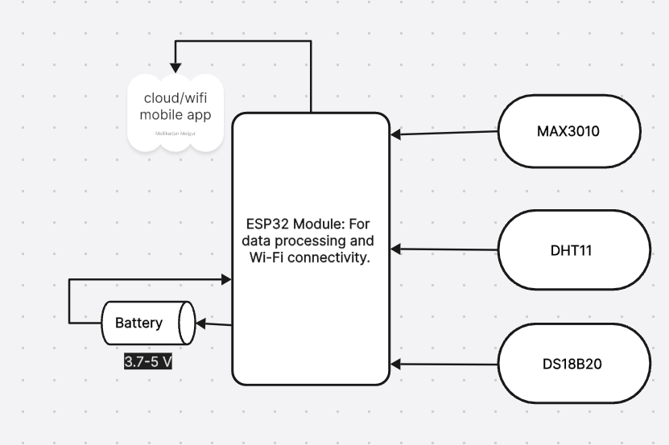


BLOCK DIAGRAM
6

Slide 8
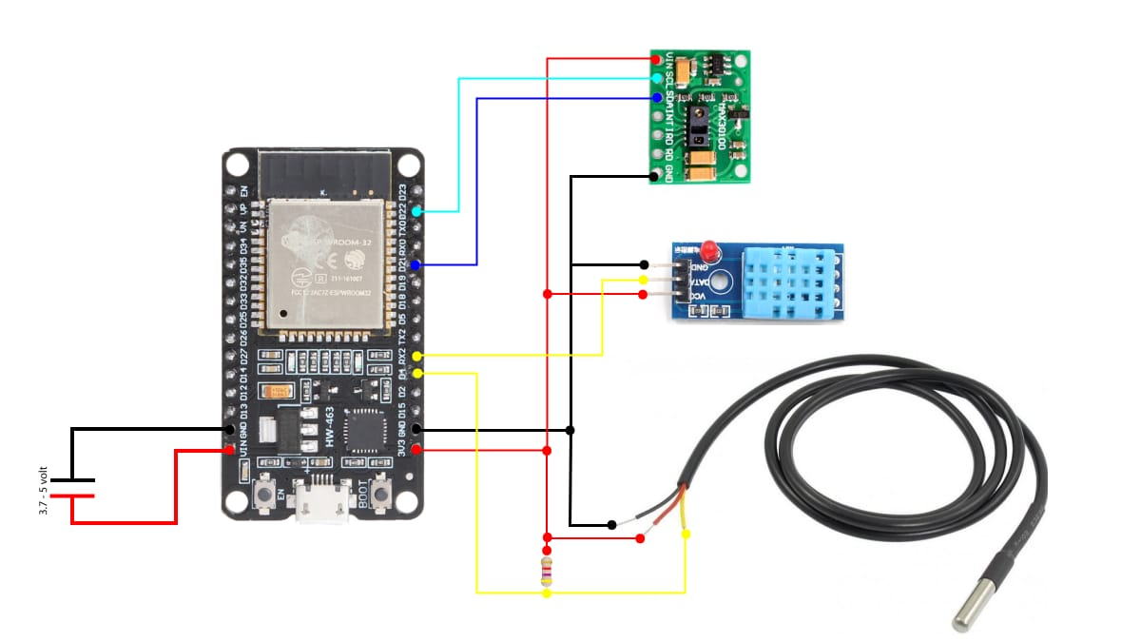
CIRCUIT DIAGRAM
7

Slide 9
Outcomes
Hardware & Software Requirements
Hardware & Software Requirements
Successfully Developed: A practical, low-cost IoT device for continuous remote monitoring of vital signs.
Successful real-time transmission of temperature, heart rate, and SpO2 data to a remote dashboard.
Enhances Patient Safety: Provides real-time data and automated alerts to caregivers, allowing for immediate response to health emergencies.
Improves Healthcare Efficiency: Reduces the need for manual checks, optimizes staff workload, and supports patient independence.
8

Slide 10
Conclusion
This project presents a practical and low-cost solution for remote patient monitoring using IoT technology.
By integrating readily available sensors with a Wi-Fi-enabled microcontroller, the system enhances patient safety and provides healthcare professionals with valuable real-time data.
This system is a powerful example of how IoT can transform patient care, making it smarter, faster, and more reliable.
9

Slide 11
Reference
YouTube:-@aslamhossain1 https://youtube.com/@aslamhossain1?si=kGmsZKuLLw9qH4ZI.
Research Papers:-“IoT Based Patient Health Monitoring System Using ESP32 and Blynk App” — IJRASET.
Github:-https://github.com/aslam-Hossain-YT/IoT-Project-using-ESP32-ESP8266
Research Papers:-“ IoT-Driven System for Continuous Monitoring of Heart Disease Patients Post-Surgery” (arXiv)
10

Slide 12
Thank you

